Slide 2
6:00-6:30
6:30-6:40 break
6:40-7:10
7:10-7:20 break
7:20-7:50
7:50-8:00 break
8:00-8:30
8:30-8:40 break
8:40-9:00

Slide 3
LEARN To
RECOGNIZE
A GOOD
KNOWLEDGE
TRANCE
Notes:
explain who frank is

Slide 4
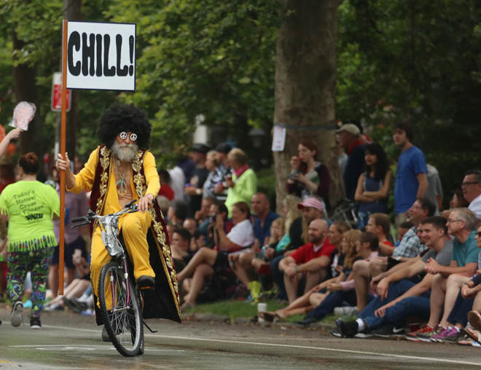
Notes:
Zigzagging through the Straight and Narrow (2009)

Slide 5
Motivation

Slide 6
BREAK FROM THE BLUB
FIGHT IRONY
PERSEVERE
Notes:
Break from the blub: recognize the value of different approaches; avoid the generalist’s trap
Fight irony: e.g. brainfuck sucks
Persevere: google is useless, docs are very terse; stackoverflow: 1.4 mil javascript tags, 32k haskell, 8k prolog, 243 j

Slide 7
J
a computer language for mathematical computations

Slide 8
J
obscure, terse, powerful,
brilliantly designed...
extraordinarily difficult to learn and teach

Slide 9
J
Example: drop lowest x grades from list y, then average the grades
((+/%#)@:((}.@:/:~)^:x)) y
add grades
take last
sort
repeat
count grades
drop lowest
the grades
divide
do left thing
after right thing is done
how many to drop

Slide 10
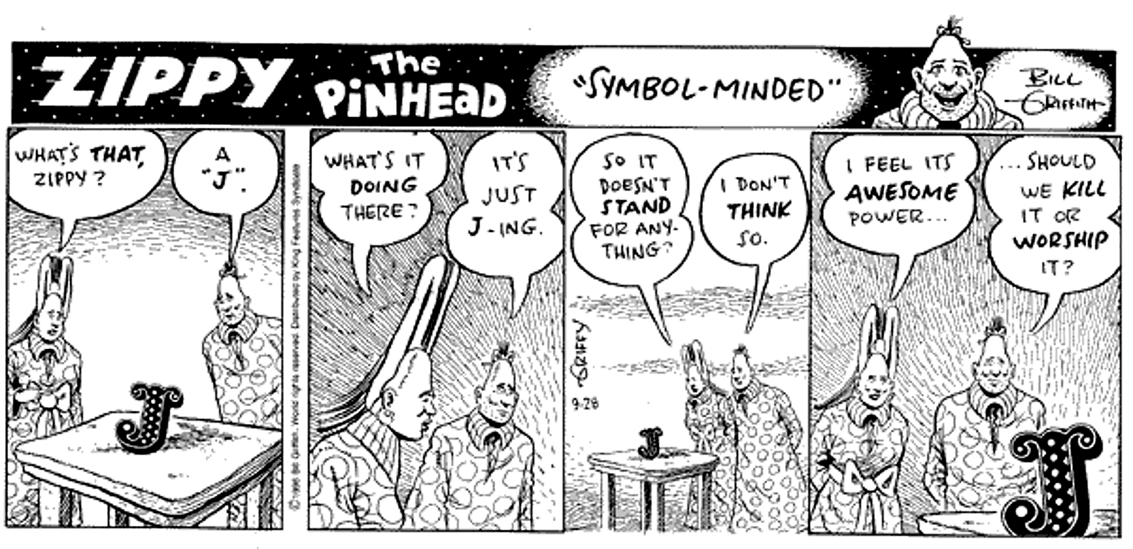

Slide 11
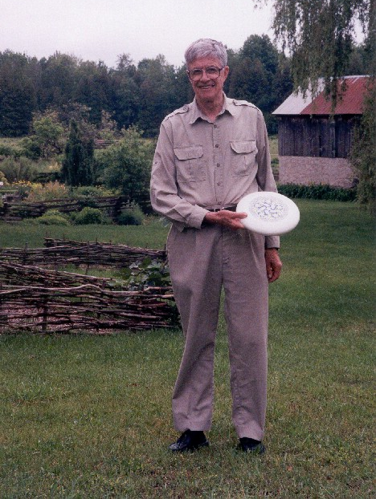
Notes:
“Ken at Kiln Farm with a prototype J Ultimate sportdisc (photo by Jana Michaud)”
http://webbox.lafayette.edu/~reiterc/j/ke_iverson/index.html

Slide 12
J system, v1
typedef char C;typedef long I;
typedef struct a{I t,r,d[3],p[2];}*A;
#define P printf
#define R return
#define V1(f) A f(w)A w;
#define V2(f) A f(a,w)A a,w;
#define DO(n,x) {I i=0,_n=(n);for(;i<_n;++i){x;}}
I *ma(n){R(I*)malloc(n*4);}mv(d,s,n)I *d,*s;{DO(n,d[i]=s[i]);}
tr(r,d)I *d;{I z=1;DO(r,z=z*d[i]);R z;}
A ga(t,r,d)I *d;{A z=(A)ma(5+tr(r,d));z->t=t,z->r=r,mv(z->d,d,r);R z;}
V1(iota){I n=*w->p;A z=ga(0,1,&n);DO(n,z->p[i]=i);R z;}
V2(plus){I r=w->r,*d=w->d,n=tr(r,d);A z=ga(0,r,d);
DO(n,z->p[i]=a->p[i]+w->p[i]);R z;}
V2(from){I r=w->r-1,*d=w->d+1,n=tr(r,d);
A z=ga(w->t,r,d);mv(z->p,w->p+(n**a->p),n);R z;}
V1(box){A z=ga(1,0,0);*z->p=(I)w;R z;}
V2(cat){I an=tr(a->r,a->d),wn=tr(w->r,w->d),n=an+wn;
A z=ga(w->t,1,&n);mv(z->p,a->p,an);mv(z->p+an,w->p,wn);R z;}
V2(find){}
V2(rsh){I r=a->r?*a->d:1,n=tr(r,a->p),wn=tr(w->r,w->d);
A z=ga(w->t,r,a->p);mv(z->p,w->p,wn=n>wn?wn:n);
if(n-=wn)mv(z->p+wn,z->p,n);R z;}
V1(sha){A z=ga(0,1,&w->r);mv(z->p,w->d,w->r);R z;}
V1(id){R w;}V1(size){A z=ga(0,0,0);*z->p=w->r?*w->d:1;R z;}
pi(i){P("%d ",i);}nl(){P("\n");}
pr(w)A w;{I r=w->r,*d=w->d,n=tr(r,d);DO(r,pi(d[i]));nl();
if(w->t)DO(n,P("< ");pr(w->p[i]))else DO(n,pi(w->p[i]));nl();}
C vt[]="+{~<#,";
A(*vd[])()={0,plus,from,find,0,rsh,cat},
(*vm[])()={0,id,size,iota,box,sha,0};
I st[26]; qp(a){R a>='a'&&a<='z';}qv(a){R a<'a';}
A ex(e)I *e;{I a=*e;
if(qp(a)){if(e[1]=='=')R st[a-'a']=ex(e+2);a= st[ a-'a'];}
R qv(a)?(*vm[a])(ex(e+1)):e[1]?(*vd[e[1]])(a,ex(e+2)):(A)a;}
noun(c){A z;if(c<'0'||c>'9')R 0;z=ga(0,0,0);*z->p=c-'0';R z;}
verb(c){I i=0;for(;vt[i];)if(vt[i++]==c)R i;R 0;}
I *wd(s)C *s;{I a,n=strlen(s),*e=ma(n+1);C c;
DO(n,e[i]=(a=noun(c=s[i]))?a:(a=verb(c))?a:c);e[n]=0;R e;}
main(){C s[99];while(gets(s))pr(ex(wd(s)));}
Notes:
One summer weekend in 1989, Arthur Whitney visited Ken Iverson at Kiln Farm and produced—on one page and in one afternoon—an interpreter fragment on the AT&T 3B1 computer. I studied this interpreter for about a week for its organization and programming style; and on Sunday, August 27, 1989, at about four o'clock in the afternoon, wrote the first line of code that became the implementation described in this document.
Arthur's one-page interpreter fragment is as follows.

Slide 13
Leaping head first into the stream of consciousness is good for your balance

Slide 14
Syntax

Slide 15
Statements are exactly one line long
Numbers may be written 2, _2, 0.5
Adjacent numbers make a list: 3 _5 2.333 7
Everything else is a “word”:
Verbs: +, -, %, etc.
Adverbs: ~, /, }, etc.
Others: =., =:, NB., etc.
Notes:
2p1: 2*pi^1
2p5: 2*pi^5

Slide 16
Evaluation Rules

Slide 17
Forget the table of operator precedence!
J for C Programmers

Slide 18
RTL Evaluation:
2*4+5
18
2+4*5
22
(2*4)+5
13
Notes:
No precedence rules except parentheses ()

Slide 19

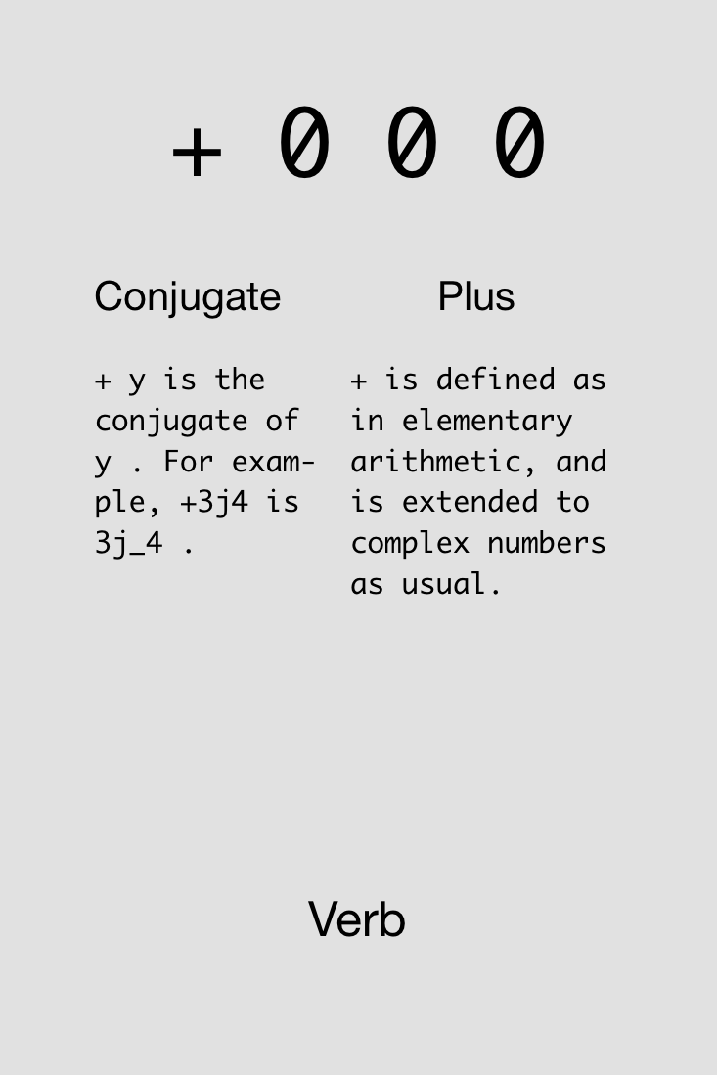
Notes:
Show example in J: 4+5+2

Slide 20

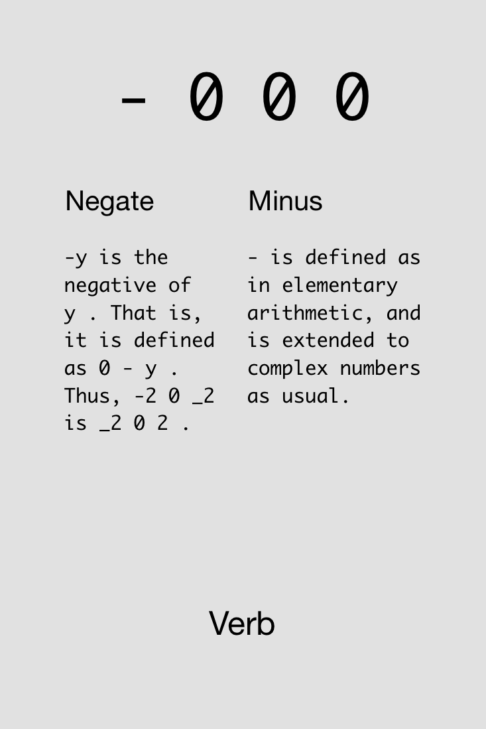

Slide 21
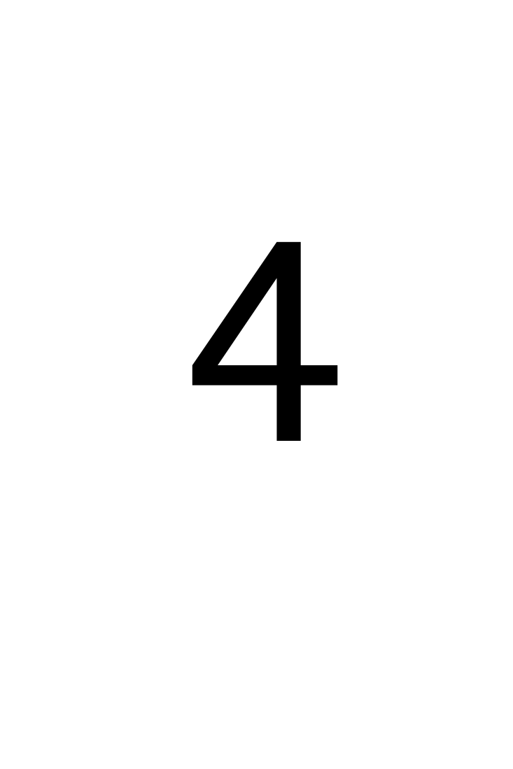
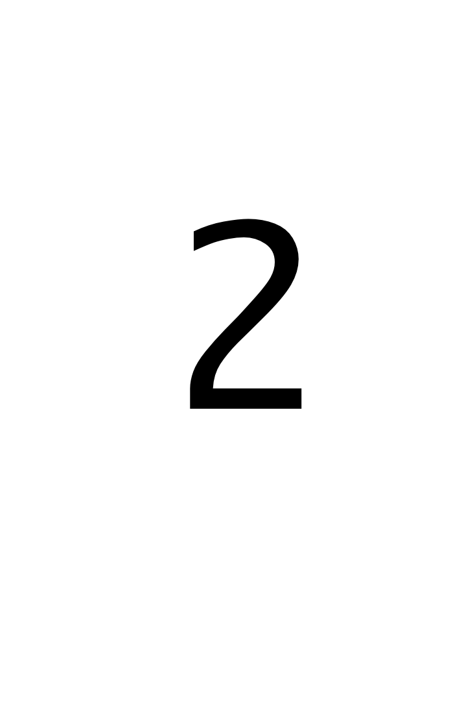
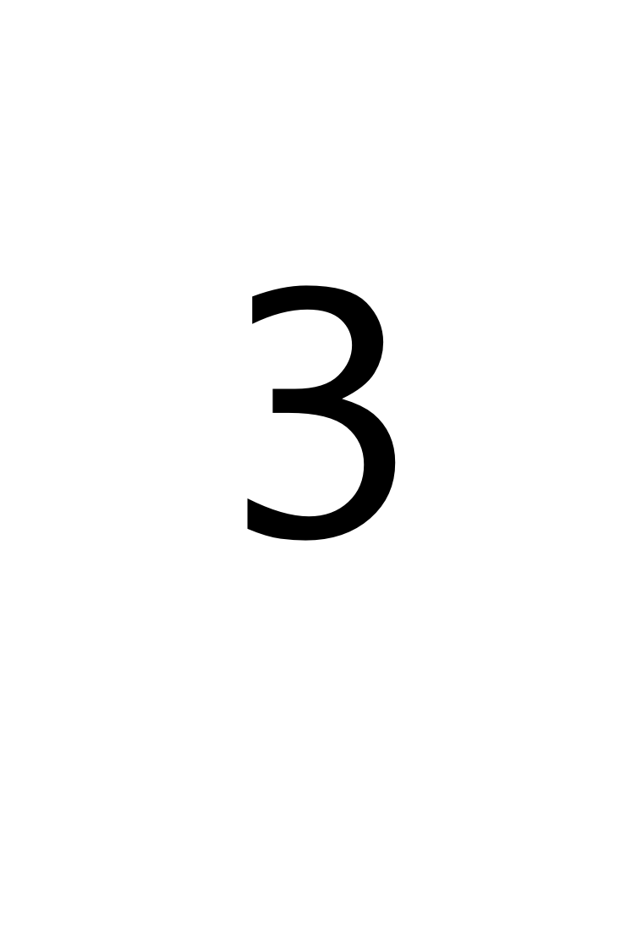


Challenge!
Compute 4-3+2 (which = 3). Try reorderings: 4+2-3, etc.
Find four solutions using all of these cards simultaneously:
4x
4x
4x
4x
4x
2x
2x

Slide 22
Solutions!
Compute 4-3+2 (which = 3).

Slide 23
Solutions!
Compute 4-3+2 (which = 3).

Slide 24

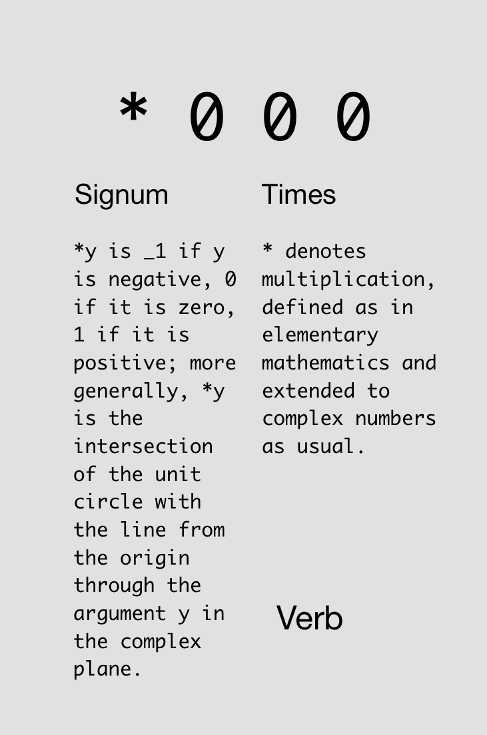

Slide 25

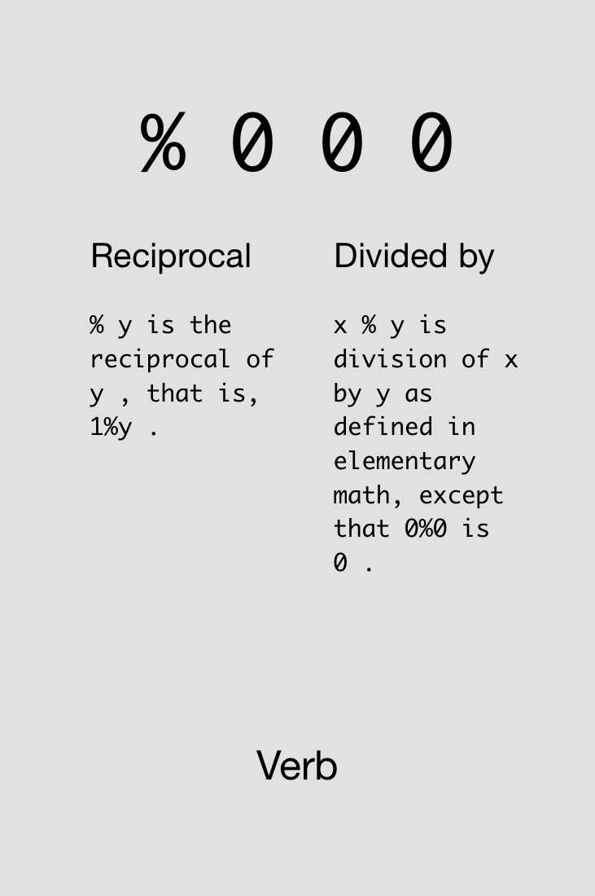

Slide 26
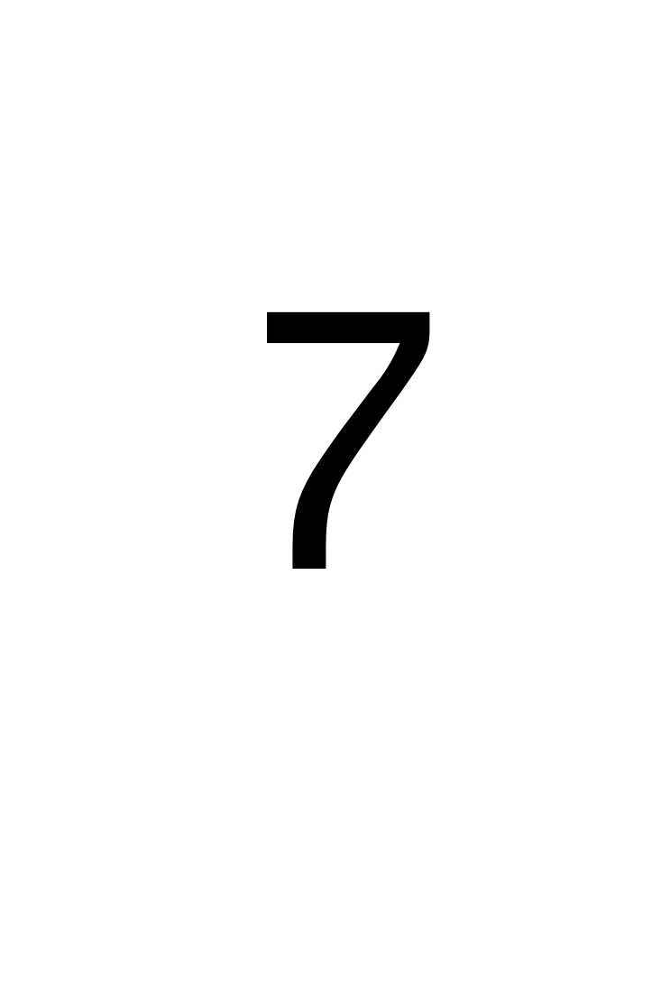
Challenge!
Compute the average of 4 and 7.
Find two solutions using all of these cards simultaneously:
2x
2x
3x
2x
3x
2x
2x

Slide 27
Solutions!
Compute the average of 4 and 7.

Slide 28
Monads & Dyads

Slide 29
y is right arg
x is left arg,
y is right arg

Slide 30
Monad vs. Dyad %:
2%7
0.285714
7%2
3.5
%7
0.142857
%2
0.5

Slide 31
Challenge!
Compute the average of -4 and -7.
Find three solutions using all of these cards simultaneously:
3x
3x
4x
3x
3x
4x
2x
2x

Slide 32
Solutions!
Compute the average of -4 and -7.

Slide 34
Try not to reinvent the rut

Slide 35

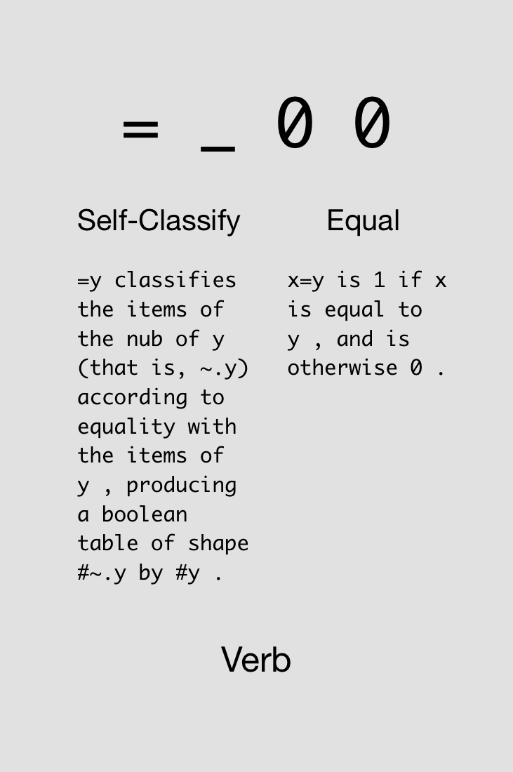

Slide 36

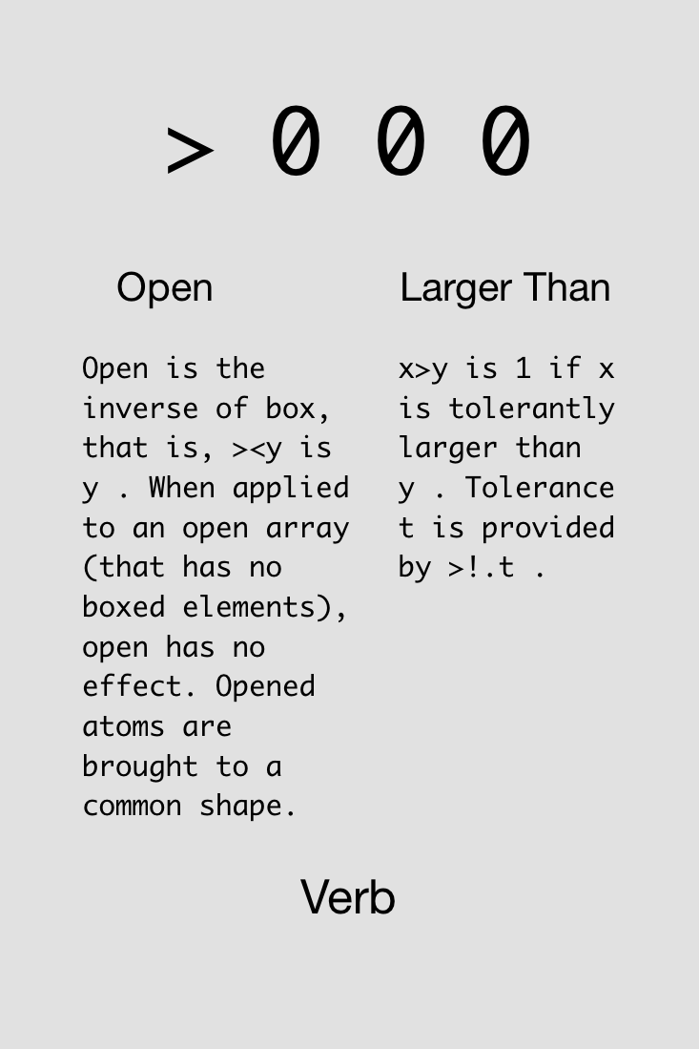

Slide 37
Examples of binary functions.
5 > 4
1
5 < 4
0
0 = 5 > 4
0
5 > 4 = 0
1 (oops, this is really 5>0!)

Slide 39
Multiplication (‘*’) can be used as “AND”.
5 > 4
1
4 > 3
1
(5>4) * (4>3)
1
(5>4) * (3>4)
0

Slide 40

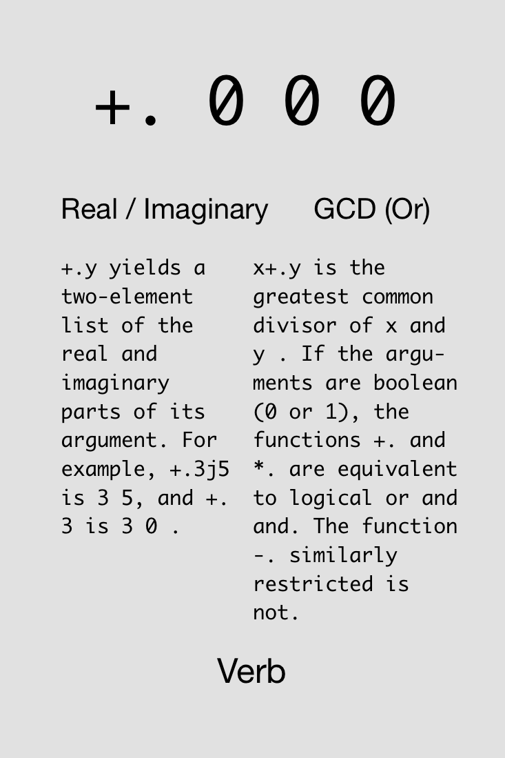

Slide 41



Challenge!
Compute 4 ≤ 5 (which = 1).
Find two solutions using all of these cards simultaneously:
3x
3x
1x
1x
1x
1x
1x
1x

Slide 42
Solutions!
Compute 4 ≤ 5 (which = 1).

Slide 43

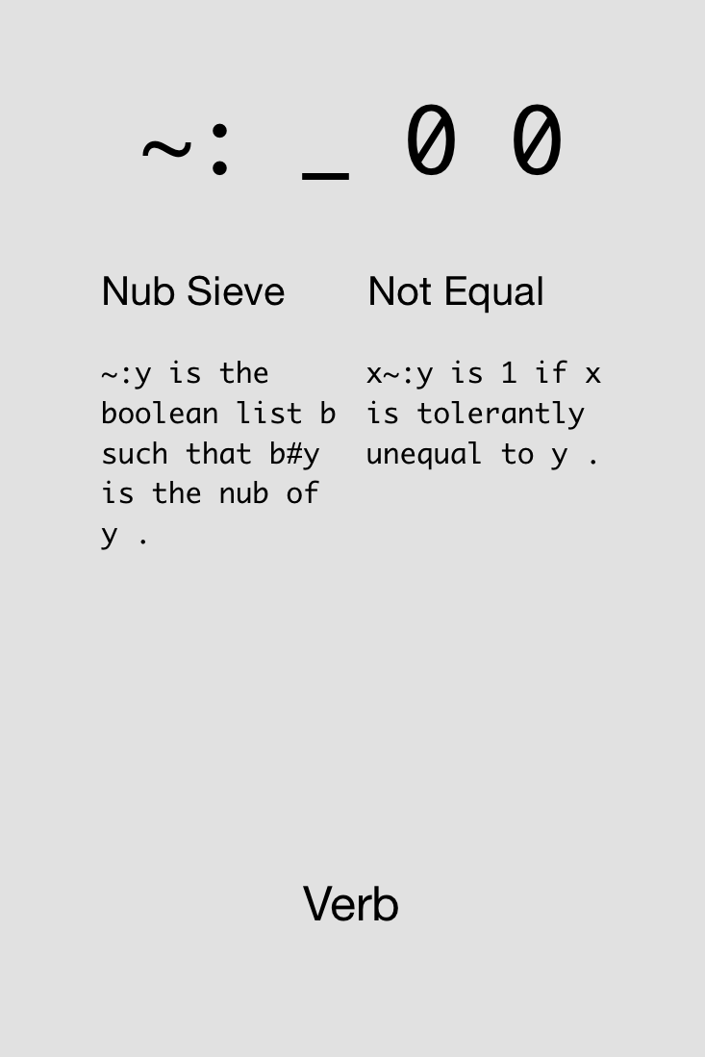

Slide 44

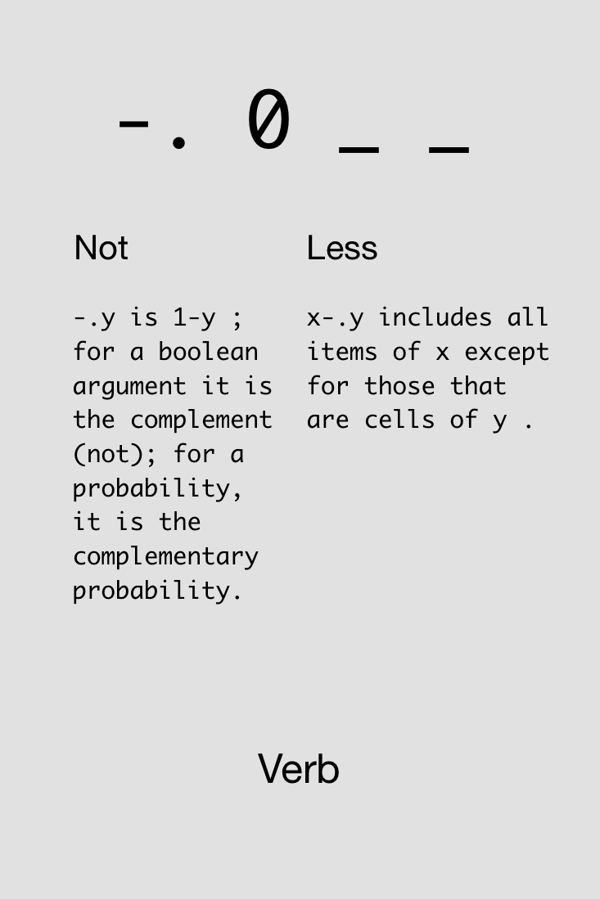

Slide 45

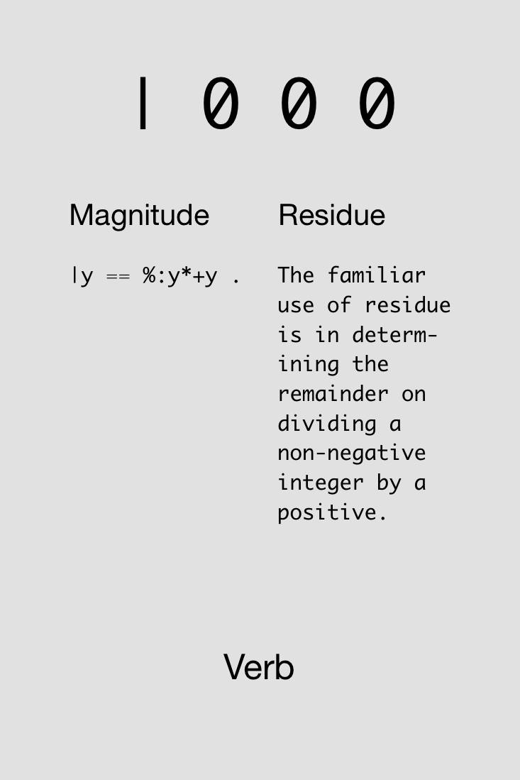

Slide 46
“Residue” gives the remainder after dividing.
2 | 5 NB. e.g., 5/2 = 2 + 1/2
1
2 | 6 NB. e.g., 6/2 = 3 + 0/2
0
3 | 8 NB. e.g., 8/3 = 2 + 2/3
2
4 | 102 NB. e.g., 102/4 = 25 + 2/4
2

Slide 47


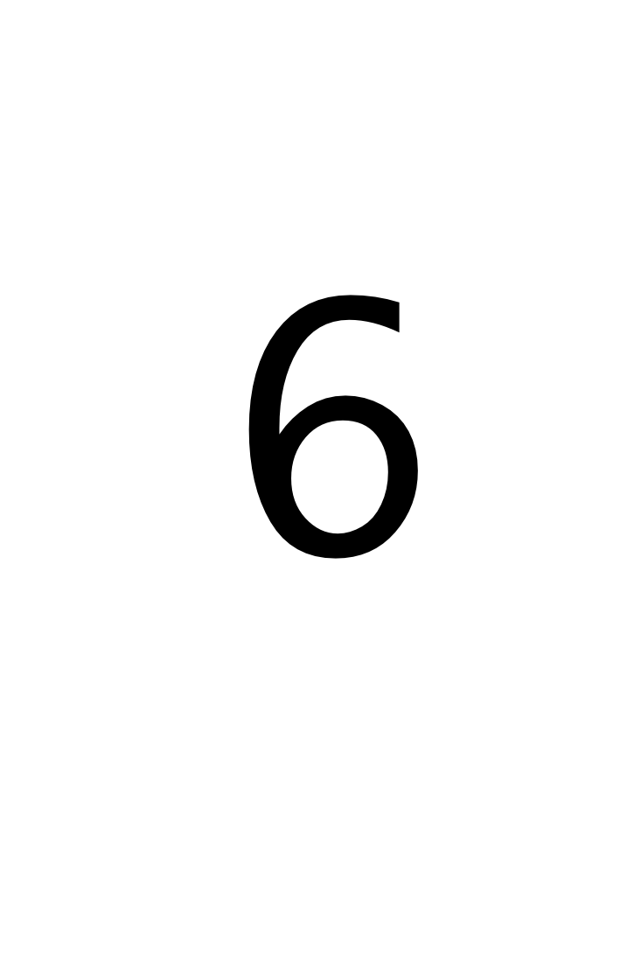
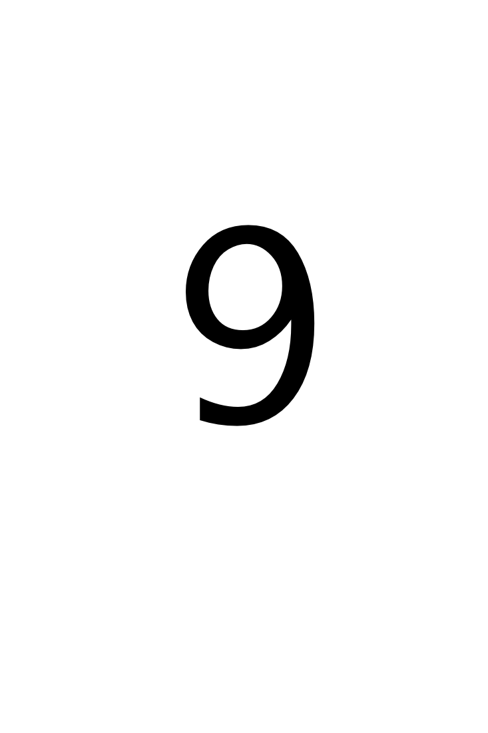
Challenge!
Determine if 1996 was a leap year. A leap year is divisible by 4 (i.e., reside is 0), but not divisible by 100.
Find one solution using all of these cards simultaneously:
1x
1x
3x
2x
4x
2x
1x
1x
1x
2x
2x

Slide 48
Solution!
Determine if 1996 was a leap year. A leap year is divisible by 4 (i.e., reside is 0), but not divisible by 100.

Slide 50
Avoid both picking at minutia and sideswiping mountains

Slide 51
Arrays

Slide 52
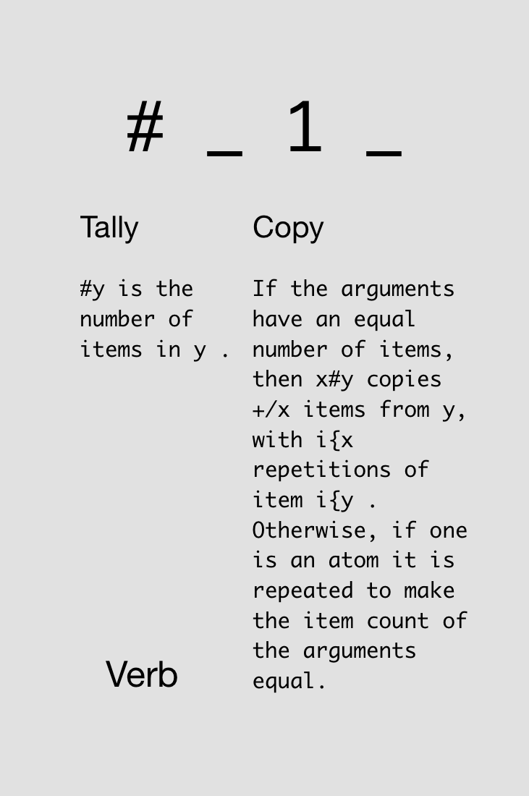

Notes:
Just monadic form

Slide 53
Typing arrays and asking their size:
5 3 7 9
5 3 7 9
# 5 3 7 9
4
# 7
1
# # 1 2 3
1

Slide 54
In J, every operator has a loop built in.
J for C Programmers

Slide 55
Automatic element-by-element operations:
1 2 3 + 4 5 6
5 7 9
1 + 4 5 6
5 6 7
1 2 + 4 5 6
|length error
| 1 2 +4 5 6

Slide 56
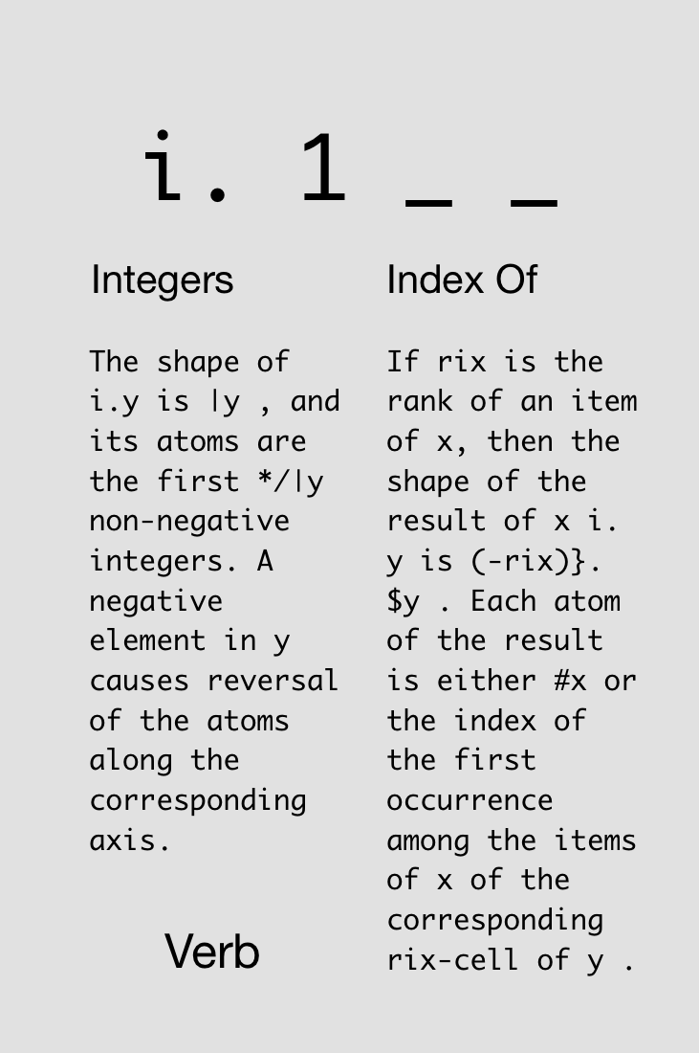


Slide 57
Notes:
Now dyadic form

Slide 58
i.4
0 1 2 3
3+i.4
3 4 5 6
3#i.4
0 0 0 1 1 1 2 2 2 3 3 3
#3#i.4
12
3##i.4
4 4 4

Slide 59
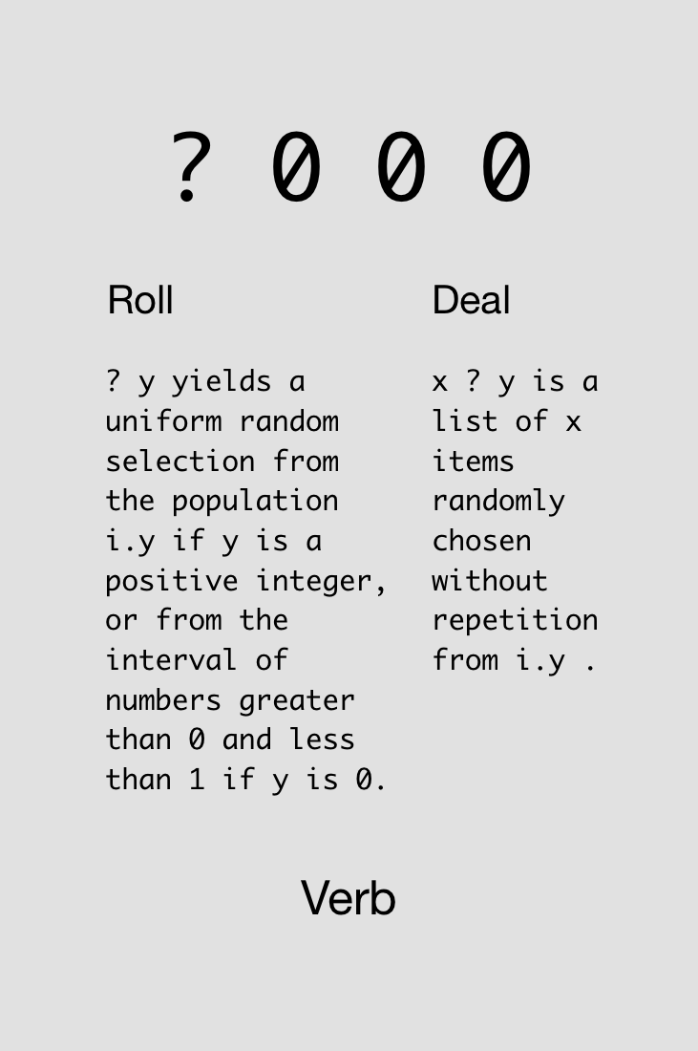



Slide 60
?5
1
?5
4
?0
0.654682
?5 2 3 6
3 1 0 4
3?7 NB. takes 3 numbers from i.7
NB. without replacement
1 4 2

Slide 61

FIX
Challenge!
Roll five d20 dice with +3 modifiers on all rolls.
Find four solutions using all of these cards simultaneously:
4x
4x
4x
4x
4x
4x
4x
2x
Notes:
>: intentionally not described ahead of time

Slide 62
FIX
Solutions!
Roll five d20 dice with +3 modifiers on all rolls.

Slide 63
FIX
Solutions!
Roll five d20 dice with +3 modifiers on all rolls.

Slide 64
Adverbs
Notes:
Loopless coding

Slide 65
A noun holds data; a verb operates on one or two nouns to produce a result which is a noun; an adverb operates on one noun or verb to produce a derived entity.
J for C Programmers

Slide 66
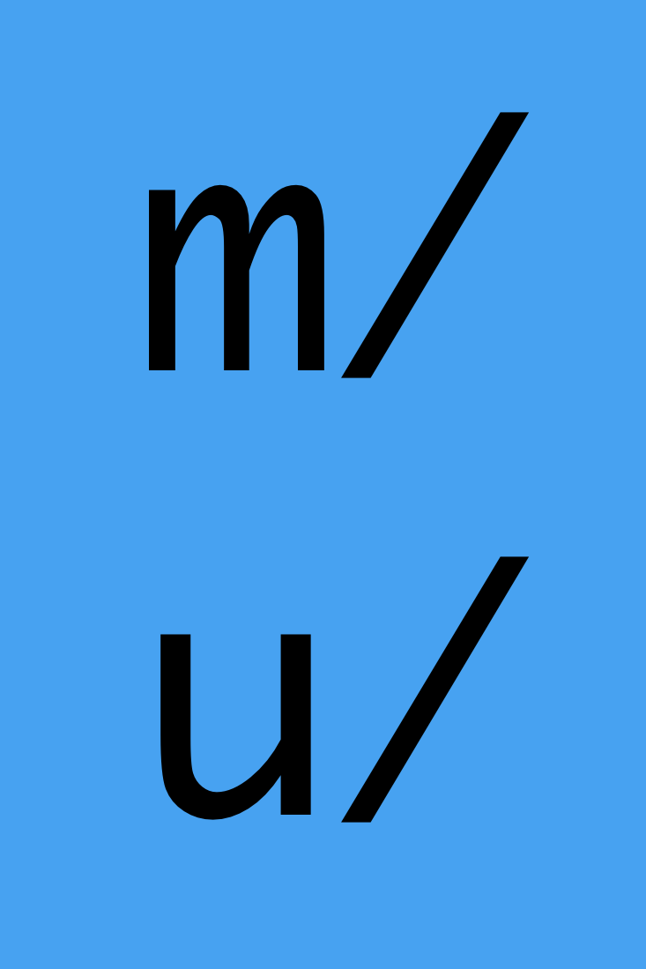
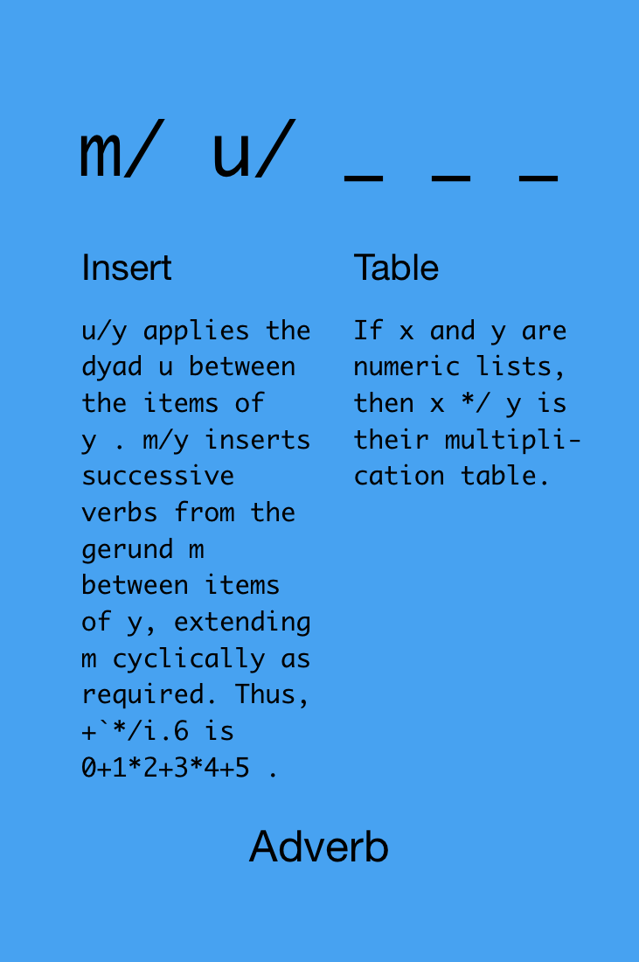

Slide 67
1+2+3+4+5
15
+/1 2 3 4 5
15
*/1 2 3 4 5
120

Slide 69
Devalue having

Slide 70
Hooks & Forks

Slide 71
Hooks
fg
Monadic
fg y == y f (g y)
-% y == y - (% y)
Dyadic
x fg y == x f (g y)
x -% y == x - (% y)

Slide 72
f =: monad : '0=2|y' NB. checks that y is even
i.10
0 1 2 3 4 5 6 7 8 9
f i.10
1 0 1 0 1 0 1 0 1 0
NB. use # operator to keep only evens
(f i.10) # i.10
0 2 4 6 8
NB. use a hook
(#~f) i.10 NB. i.e., i.10 #~ (f i.10)
0 2 4 6 8 NB. i.e., (f i.10) # i.10

Slide 73
Forks
fgh
Monadic
fgh y == (f y) g (h y)
-+% y == (- y) + (% y)
Dyadic
x fgh y == (x f y) g (x h y)
x -+% y == (x – y) + (x % y)

Slide 74

Challenge!
Define the arithmetic mean and geometric mean for any list of numbers. Geometric mean = (x₁*x₂*…*x_{n})^(1/n).
Find one solution for each kind of mean using all of these cards simultaneously:
1x
2x
1x
1x
2x
1x

Slide 75
Solutions!
Define the arithmetic mean and geometric mean for any list of numbers.
arithmetic mean
geometric mean

Slide 76
f =: -@:% NB. same as & in monadic form
f 1 2 3 4 5
_1 _0.5 _0.333333 _0.25 _0.2
10 f 1 2 3 4 5 NB. i.e., - (x % y)
_10 _5 _3.33333 _2.5 _2
f =: +/@:% NB. i.e., +/ (% y)
f 1 2 3 4 5 NB. i.e., sum reciprocals of y
2.28333

Slide 78
Never put a seat belt around your intuition

Slide 80
If you’re lucky enough to experience a miracle,
try not to micro manage it

Slide 82
Sliding your brain into neutral
engages your spiritual transmission

Slide 83
Visualization

Slide 84


Slide 86
STAY
IN THE
PLEASANT
TENSE

